Slide 1
MYLEGION: Understanding My Groups
Understand group management. View and email members and officers, edit group contact information, and review officer materials.
July 2024
Notes:
MyLegion is The American Legion’s membership website. Through MyLegion, members of The American Legion and Sons of the American Legion can view and manage their membership on file at National Headquarters. Adjutants and commanders, through their individual accounts, will have a My Groups area to assist with post and squadron administrative tasks.

Slide 2
GROUP | ADMINISTRATIVE OFFICERS
Post Post Officer | Post Adjutant & Commander
Squadron Squadron Officer | Squadron Adjutant & Commander
County County Officer | County Adjutant & Commander – View Only
District District Officer | District Adjutant & Commander – View Only
Detachment Detachment Officer | Detachment Adjutant & Commander
Department Department Officer | Department Adjutant & Commander
GROUP DEFINITIONS
Notes:
Groups are defined as a post, squadron, county, district, detachment and department.
With each group, adjutants and commanders will have an officer’s group. Officer groups provide a listing of current and future officers. It is not the group to select to preform administrative tasks.
District and county group access does not include online membership processing or the ability to edit member information.

Slide 3
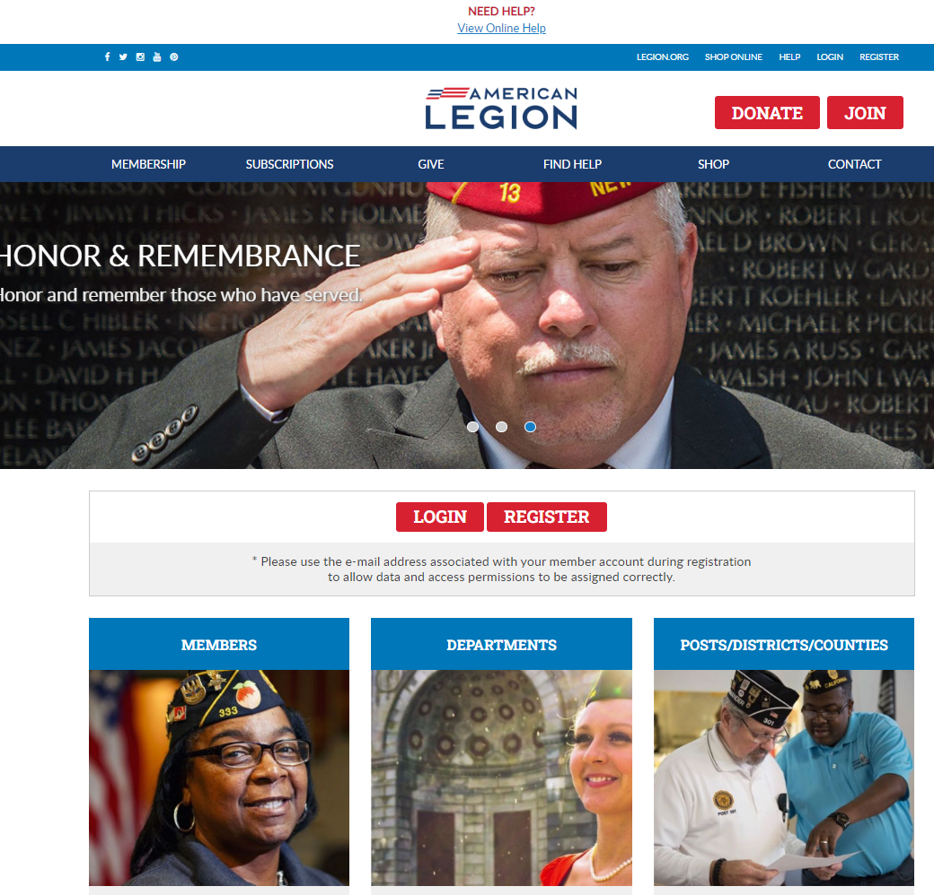
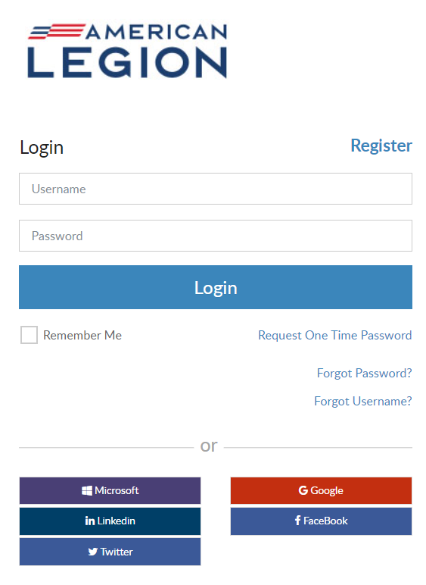
MYLEGION.ORG
Notes:
Log into MyLegion. All MyLegion accounts are registered to your individual member account using the primary email address on your record. Do not register a myLegion account with an email used by a group.

Slide 4
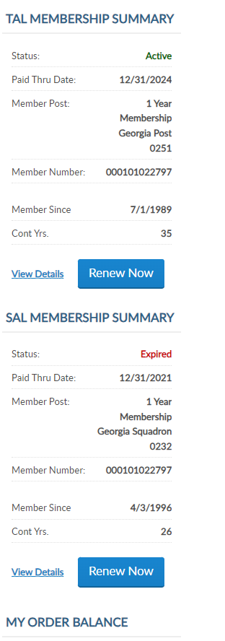
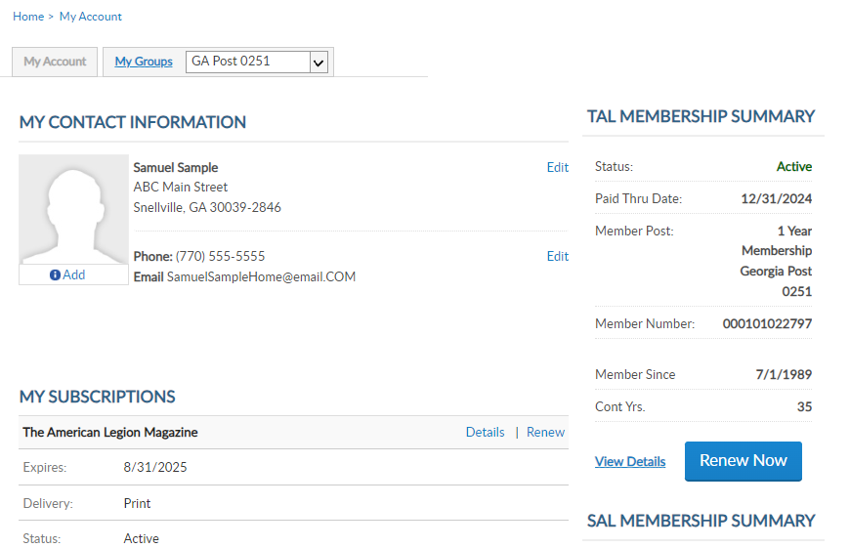
MYLEGION.ORG
My Account
Personal Member Info
My Groups
Adjutants & Commanders
Post, Squadron
District, County (View only)
Department, Detachment
Assigned Administrators
123456789
123456789
Notes:
When you log into MyLegion your My Account page displays information about your individual membership.
Adjutants and commanders of posts, squadrons, districts, counties, departments and detachments will have a My Groups menu when they are record in national’s membership system. The group menu is related to your position as an adjutant and commander. Members who have been assigned permission by one of the administrative officers will also have a My Groups menu. My groups is the administrative side of myLegion.

Slide 5
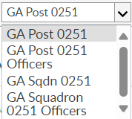
MYLEGION.ORG
My Groups Menu
Post Adjutant & Commander
Post
Post Officers (view only)
Squadron
Squadron Officers (view only)
123456789
123456789
Notes:
This member is a post adjutant and has 4 groups by default. <1> Legion leadership have access to both Legion and Sons of the American Legion groups. Officer groups are view only to see contact information for officers on file.
Clicking on the group will navigate you to the administrative side of MyLegion. Let’s look at an officer’s group.

Slide 6
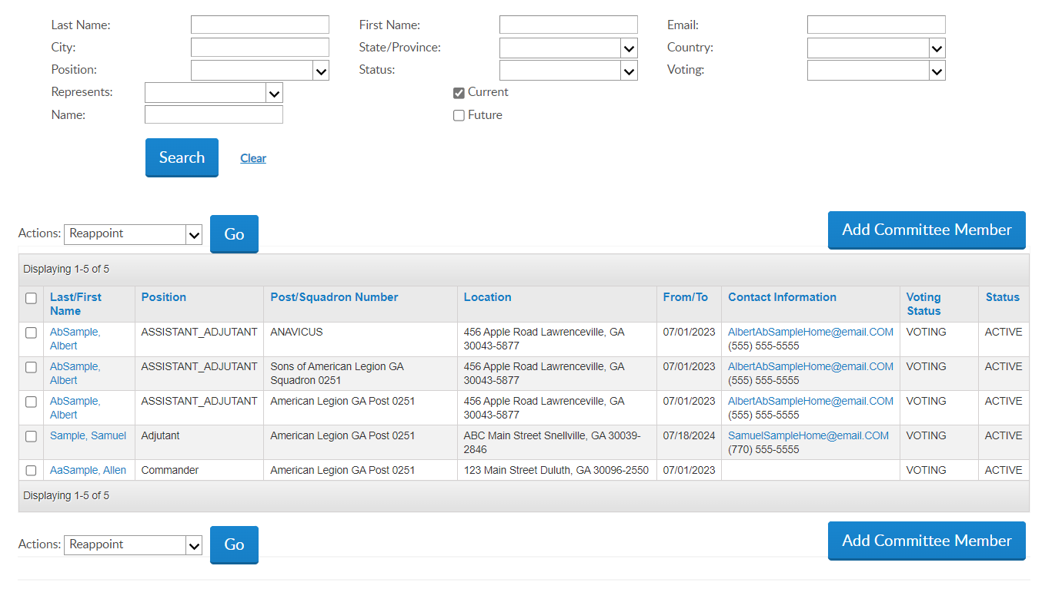
OFFICER GROUPS
Officer Groups
View only
Current, Future
Report officers to dept. HQs
Email Single Member
Click on email address to open browser.
Email list of Officers or Selected
Select All (title row)
Check Individuals
Actions “Send Email”
Blind Copied
Notes:
In the officer group you can view and email officers reported in national’s membership system. MyLegion does not allow adding or reappointment officers. Report officers through your department headquarters using the Officer Certification form. Officer updates cannot be made through MyLegion.
The officer list will allow you to send an email. Click on the email address of a single member and an email will open. <1>

Slide 7
EMAIL FROM MYLEGION
Email default app is Microsoft Outlook.
To change default app, search computers “Default Apps” to update.
Notes:
MyLegion sends the email to Microsoft Outlook by default. If the email does not open as expected, go to your computers default apps and set your web browser to Outlook.

Slide 8
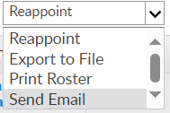
EMAIL FROM MYLEGION
Email multiple officers or selected officers.
Select All (title row)
Check Individuals
Actions “Send Email”
Blind Copied
Notes:
To email all officers in the list, click on the title row to check all. Go to the Actions menu and select “Send Email” and click Go. <1>

Slide 9
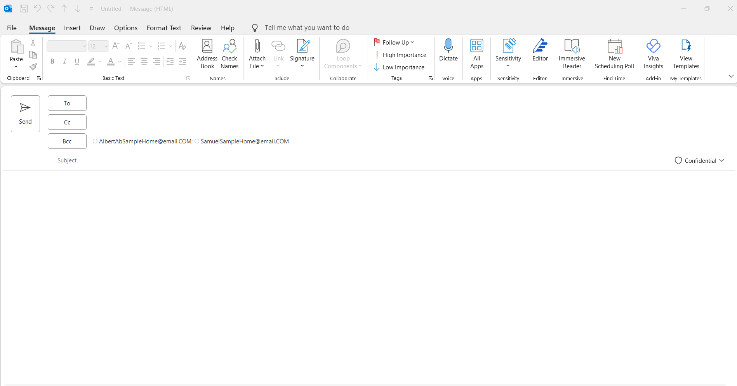
EMAIL FROM MYLEGION
Notes:
Notice the email addresses are in as a blind copy. Recipients of the email cannot see who else received the message.

Slide 10
OFFICER GROUPS
Navigation
Breadcrumb Links
My Groups Menu
My Account
Notes:
Navigating through My Groups can be done by using the breadcrumb links at the top of the page.
Using the My Groups menu you can go from one group to another. Use the pull-down menu and select the desired group. Post and squadron groups take you to the administrative side of MyLegion.
You can return to your personal member information by clicking My Account. Let’s begin from the administrative page by clicking Group Profile from the breadcrumb link. <1>

Slide 11
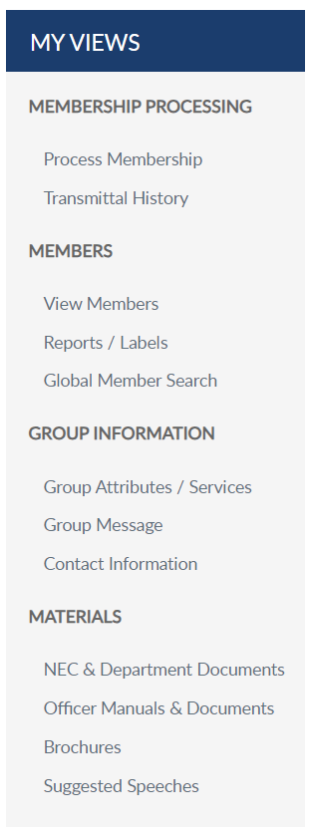
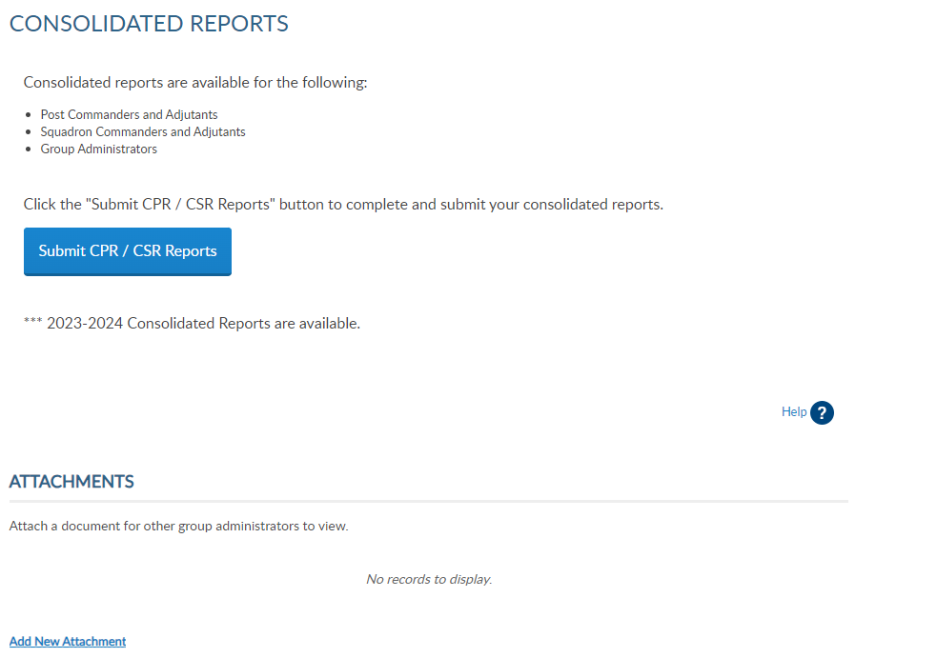
GROUP PROFILE
Consolidated Reports
Online CPR/CSR
Membership Processing
Renew, Add, Transfer
Members
View Members / Mbr Management
Reports
Group Information
Contact Information
Materials
Manuals, Brochures, Speeches
Notes:
The groups area has a left hand “My Views” menu with links to administrative tools. Consolidated reports, <1> online membership processing and transmittal history, <2> member management and reports, <3> group information and <4> officer materials.
<5> Click on View Members to view members in the group selected.

Slide 12
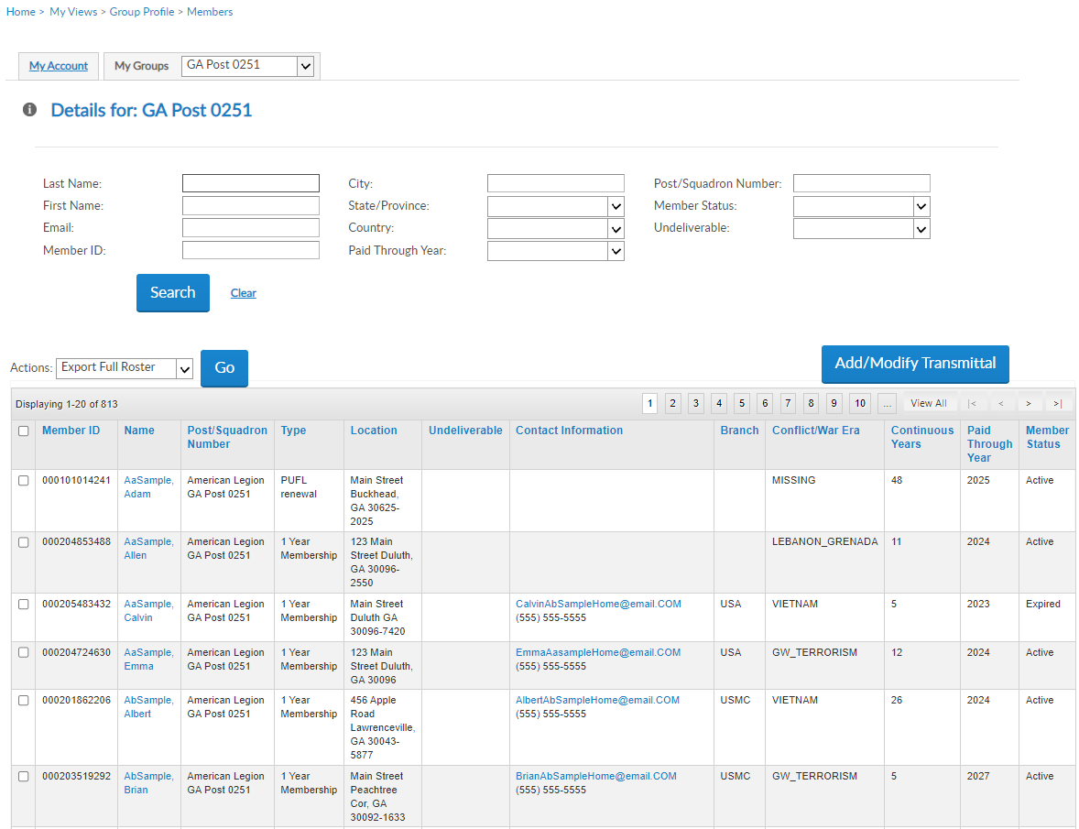
VIEW MEMBERS
View Members List
Contact Information
Member Status
Search Members
Filter Options
Edit
Send Emails
Reports located in another menu option.
Add/Modify Transmittal
Not available to districts and counties.
000123456781
000123456782
000123456783
000123456784
000123456785
000123456786
Notes:
Administrators at all levels can view members. The post profile, or View Member’s list provides a quick view of member contact information and status. <1> Search filters are available to quickly search by name or ID. To view additional information and edit a member, click on the member’s name in blue to open member management options.
Districts and counties can only view member data and can use this area to view and email members. The same process is used as demonstrated in the officer’s group. Click on the individual email, check boxes to send, or click on the title band to select all.
You can also use filters to search a group of members by last paid year, member status and mail status. However, this is not the best location to print rosters and reports. A reports area is available to print rosters and reports.
<2> The Add/Modify button is only available to posts, squadrons, detachments, and departments. It opens online membership processing.
Click on the Group Profile breadcrumb <3> to return to My Groups home.

Slide 13
GROUP INFORMATION
Displays on www.Legion.org “Find a Post”
Notes:
Group Information allows officers to provide information about their attributes and services, add a group message and updated contact information. This information is displayed in Legion.org Find a Post for people to find a post in their area.

Slide 14
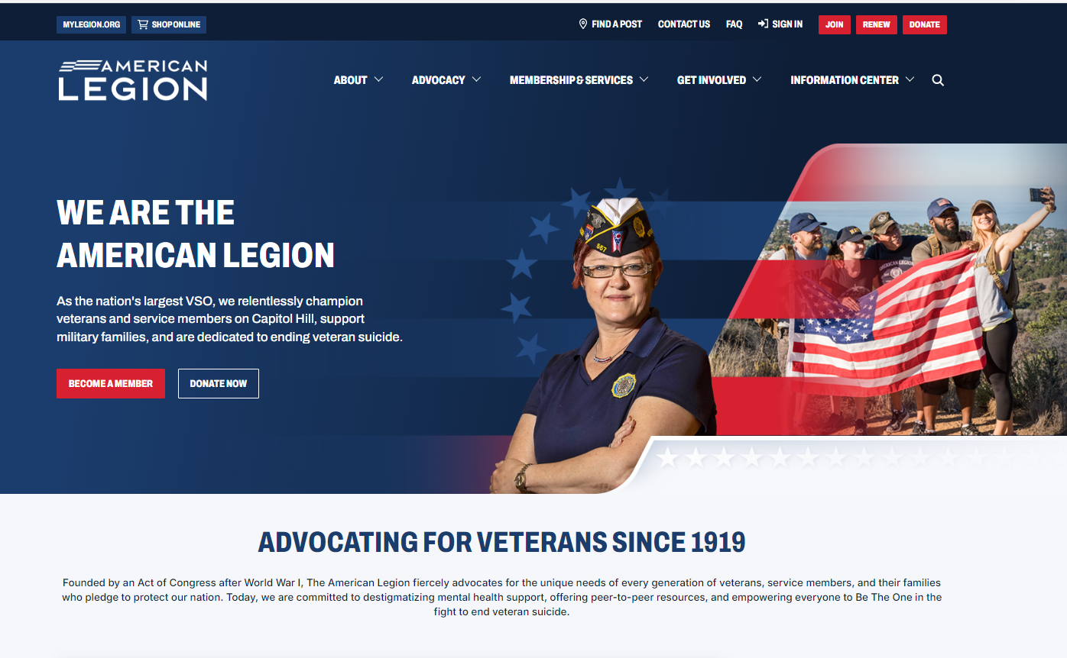
LEGION.ORG FIND A POST
Notes:
Legion.org is a public website and information is available to anyone searching for a post.

Slide 15
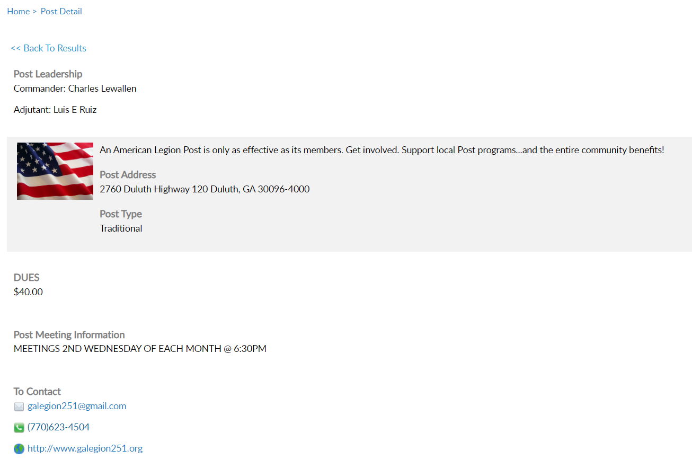
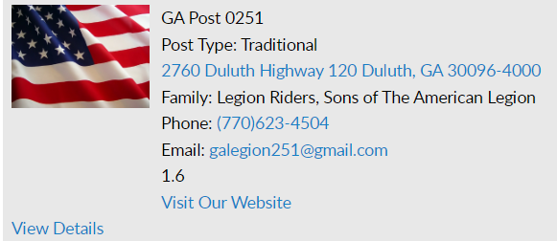
FIND A POST
Notes:
The contact information here can be maintained in MyLegion. Notice the image, legion family information and link to website. Additional information can be found in view details. <1> Post details display a custom message that you can personalize and post amenities.

Slide 16
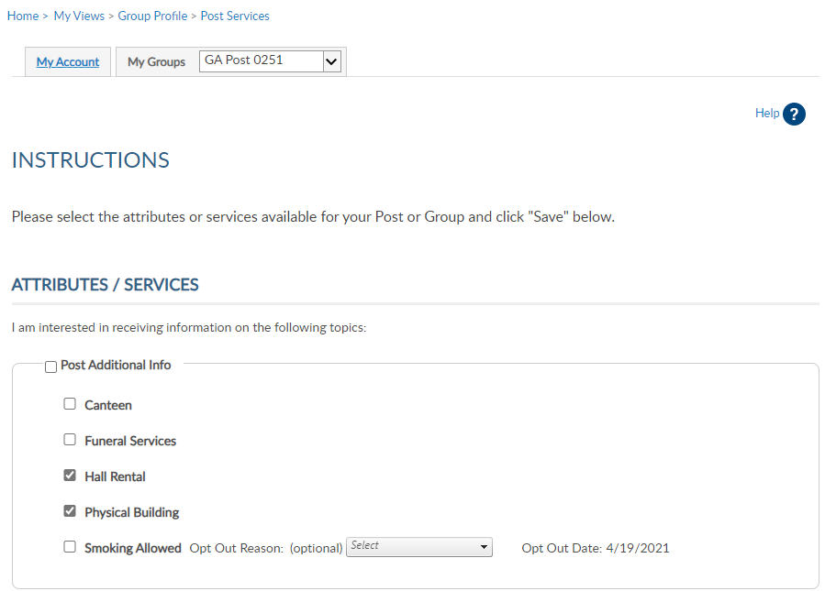
GROUP ATTRIBUTES/SERVICES
Notes:
.Group attributes can assist others interested in The American Legion and Son of the American Legion by providing additional information about your group. This information can be seen through Legion.org Find Help find a post.
Check the boxes that apply and Save. To remove, simply uncheck the appropriate box and Save updates.

Slide 17
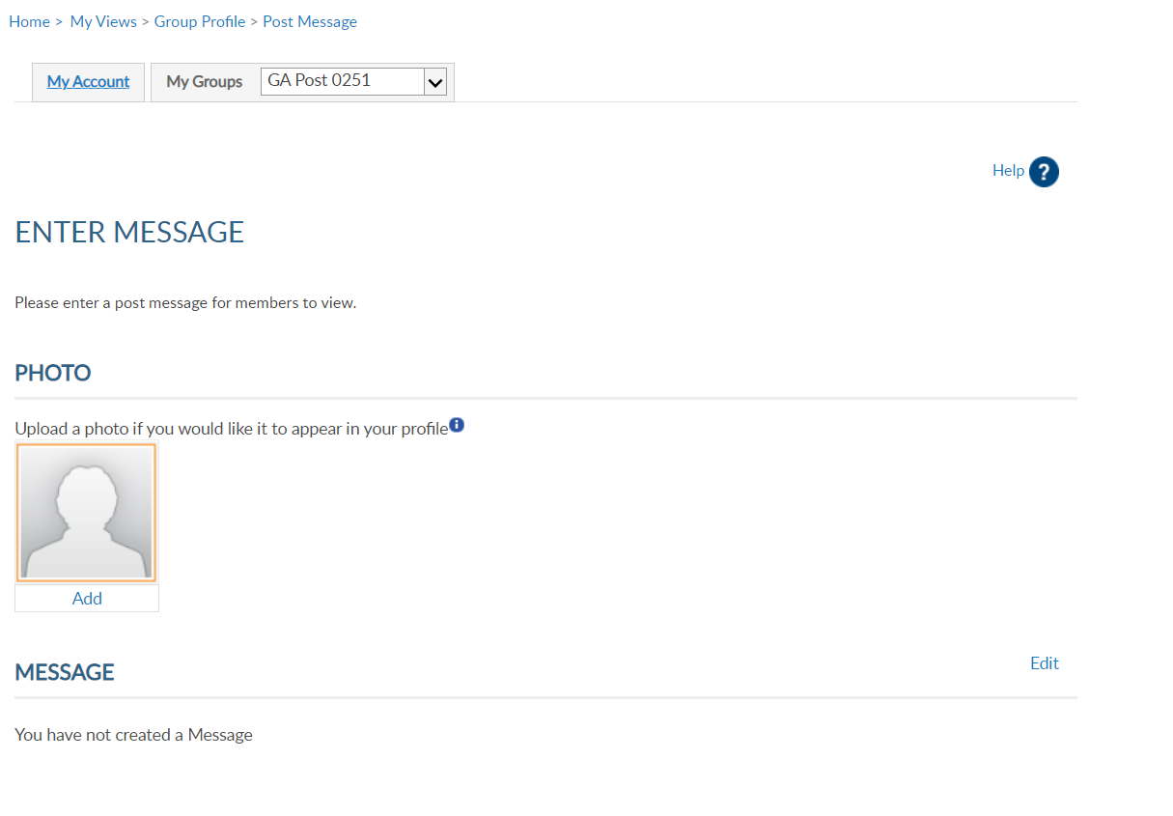
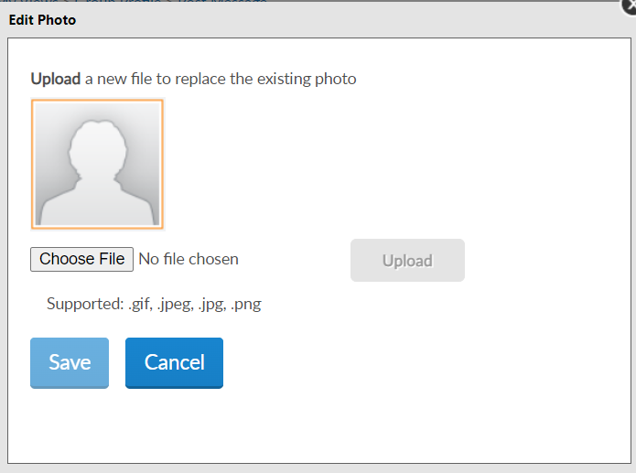
GROUP MESSAGE
Notes:
Group message includes adding a message and photo for the Find a Post.
To add a photo of your building, or other image identifying your group, click add. <1> Click choose file.

Slide 18
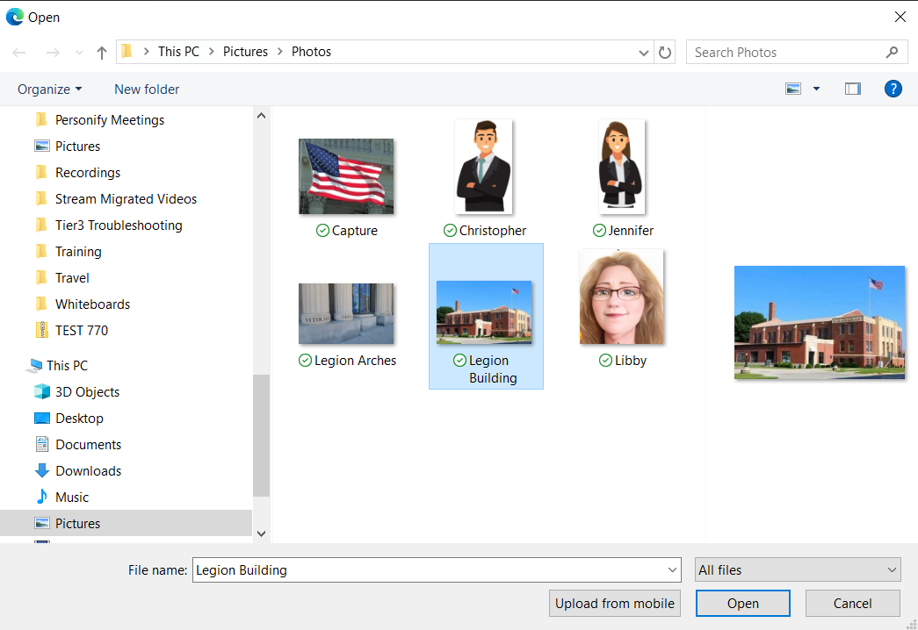
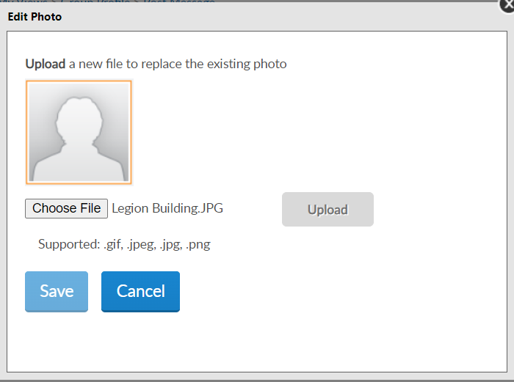
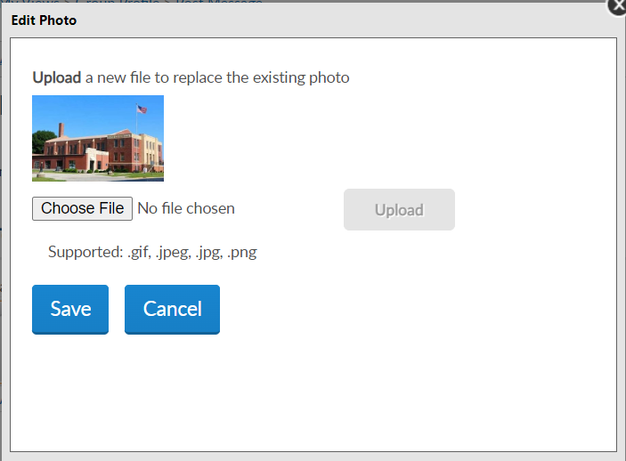
GROUP IMAGE
Locate Image:
gif, jpeg, jpg, png
Upload
Save
Notes:
Locate the image and click “Open”. <1> The edit photo window opens with the file selected. Click “Upload” for the image to appear <2> and Save.

Slide 19
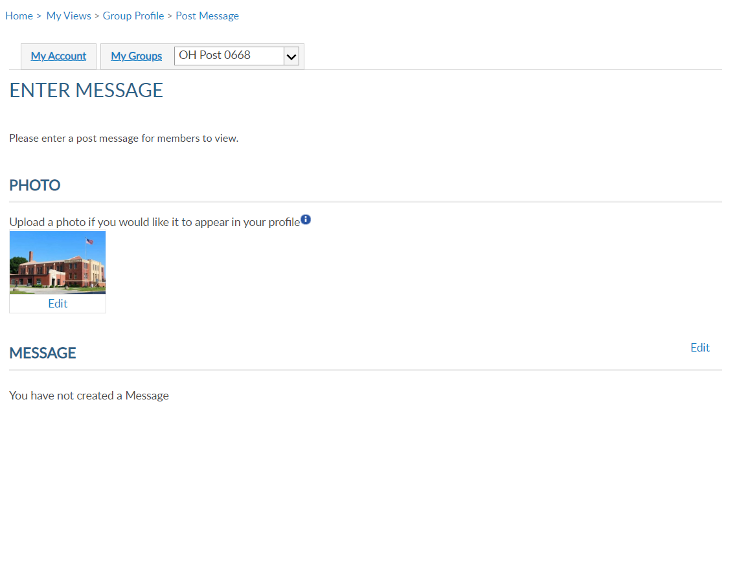
GROUP MESSAGE
Notes:
The photo image appears and will also appear in post locator, Find a Post. You can remove or edit the image using the Edit link.
<1> A brief message about meetings, special events or programs your post supports can added to your group information. It is important that if posting a message to keep it current. This message will be published to Legion.org “Find A Post”.
Click Edit to add, update or delete text.

Slide 20
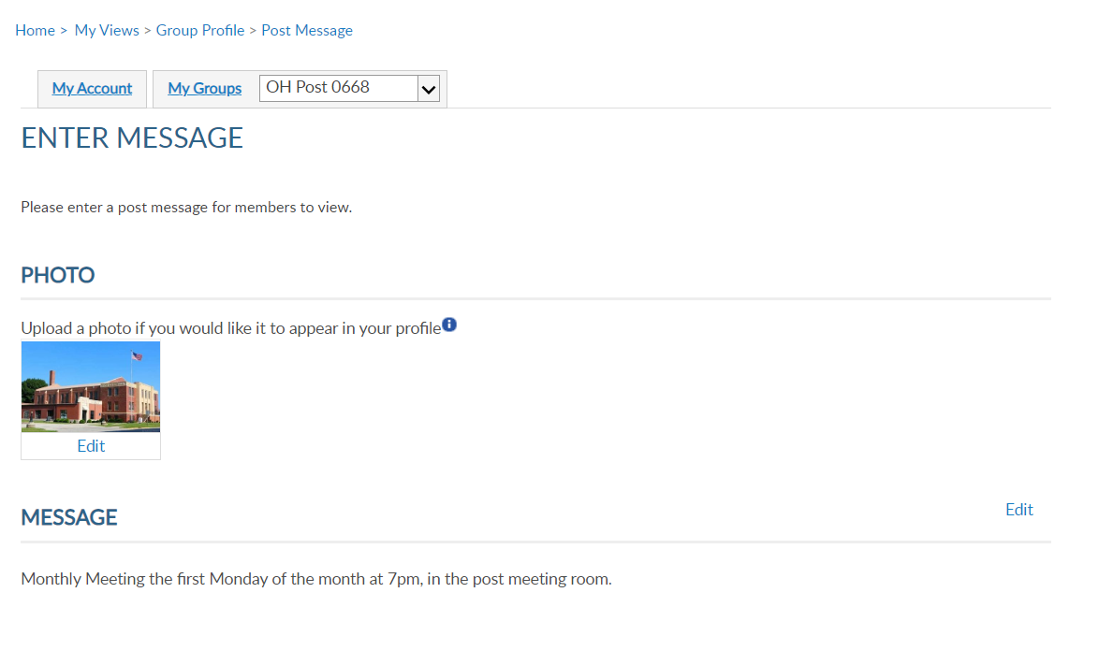
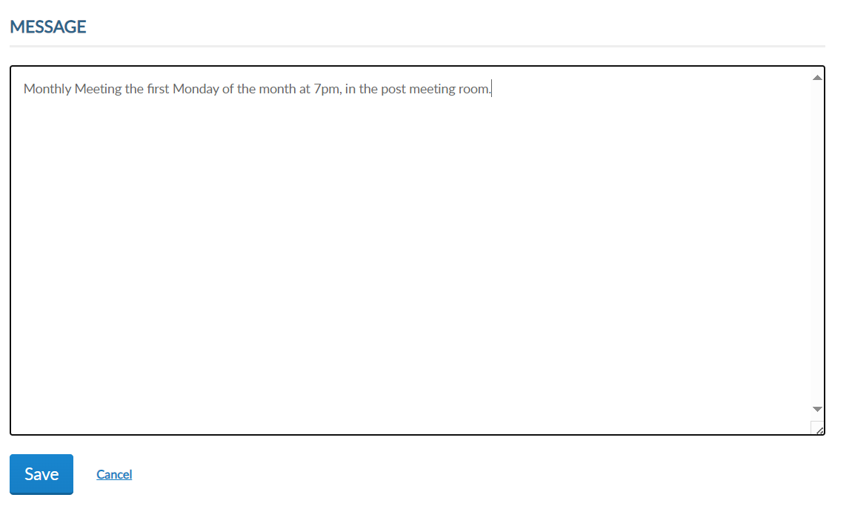
GROUP MESSAGE
Notes:
Type the message and “save”. <1>

Slide 21
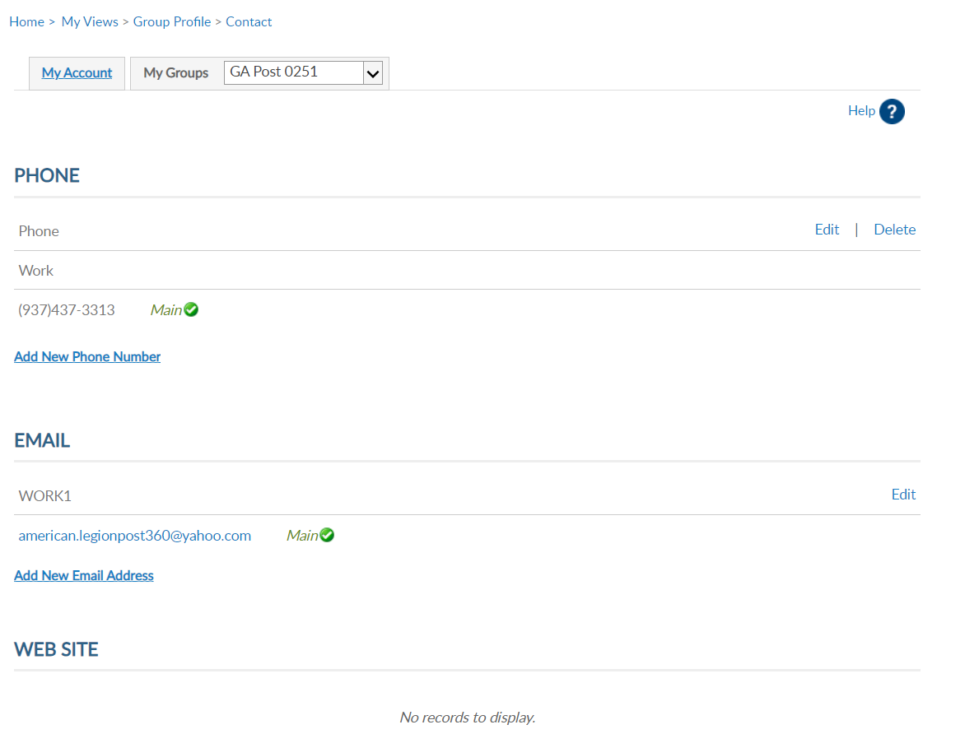
GROUP CONTACT INFO
(770)623-4504
galegion251@gmail.com
Notes:
Group contact information allows administrators to update contact information including phone, email website and fax. This information can be seen on Legion.org’s Find a Post.
Use the Add, Edit or Delete options to update group contact information.
This does not replace Post Data Reports. In February, the annual Post Data Report is mailed to department headquarters for distribution to posts. Each form is pre-printed with current contact information form National HQ’s data system. This pre-printed form for t he post is sent for annual spring reporting. When there is a change, notify department headquarter. All changes must first go through department headquarters for processing. Any changes received by NHQs directly from a post will be returned with no action taken.

Slide 22
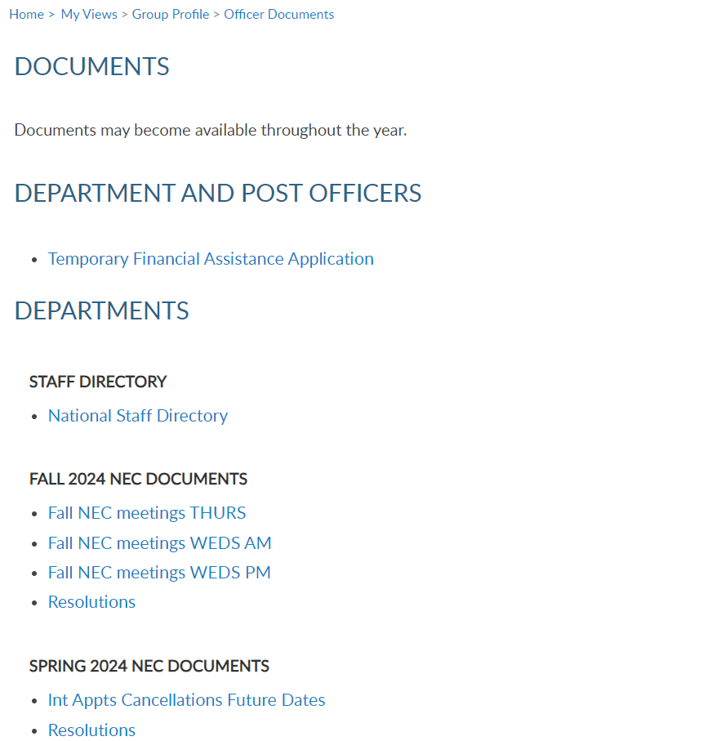
MATERIALS > DOCUMENTS
Notes:
Materials include NEC documents, manuals, brochures, and suggested speeches. The documents area includes a national staff directory, and minutes from the National Executive Committee meetings.

Slide 23
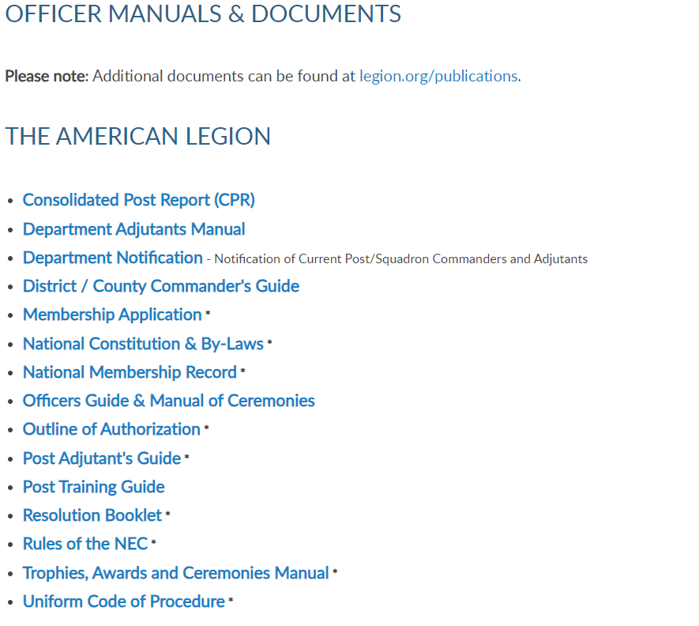
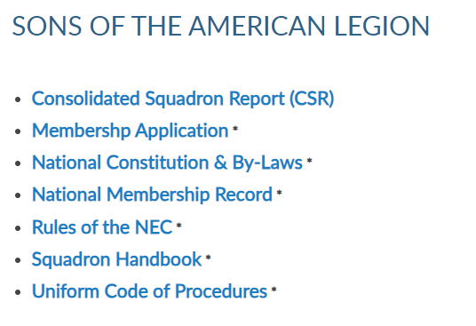
MATERIALS
Notes:
Officer Manuals are available to download. Select the title to link to publications on Legion.org to download.

Slide 24
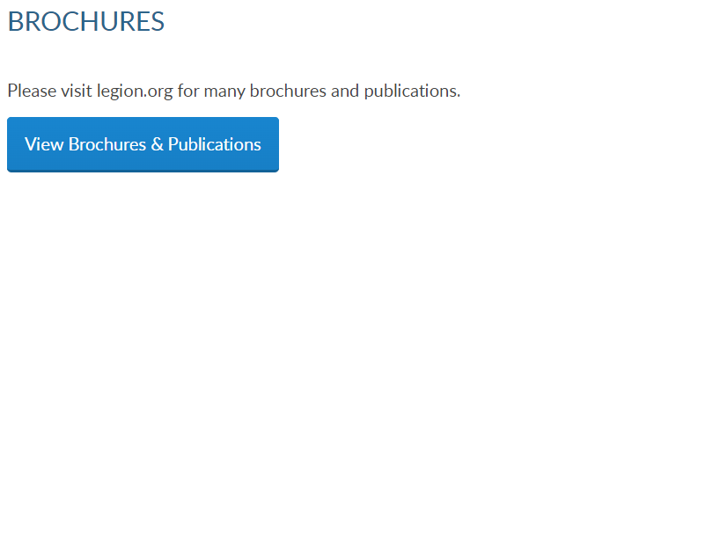
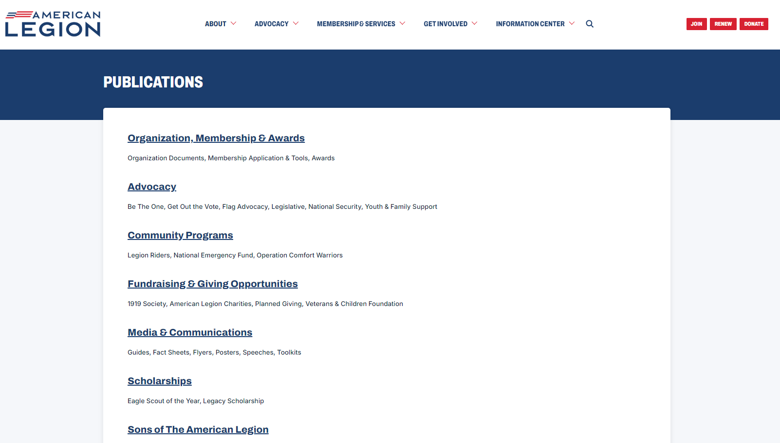
MATERIALS
Notes:
Brochures provides a link to legion.org publications page. <1>

Slide 25
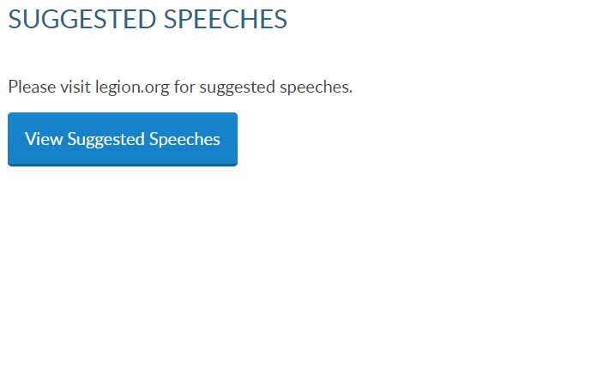
MATERIALS
Notes:
Every year The American Legion provides speeches to use as a guideline during events and observances. These speeches can be downloaded through Legion.org. <1>

Slide 26
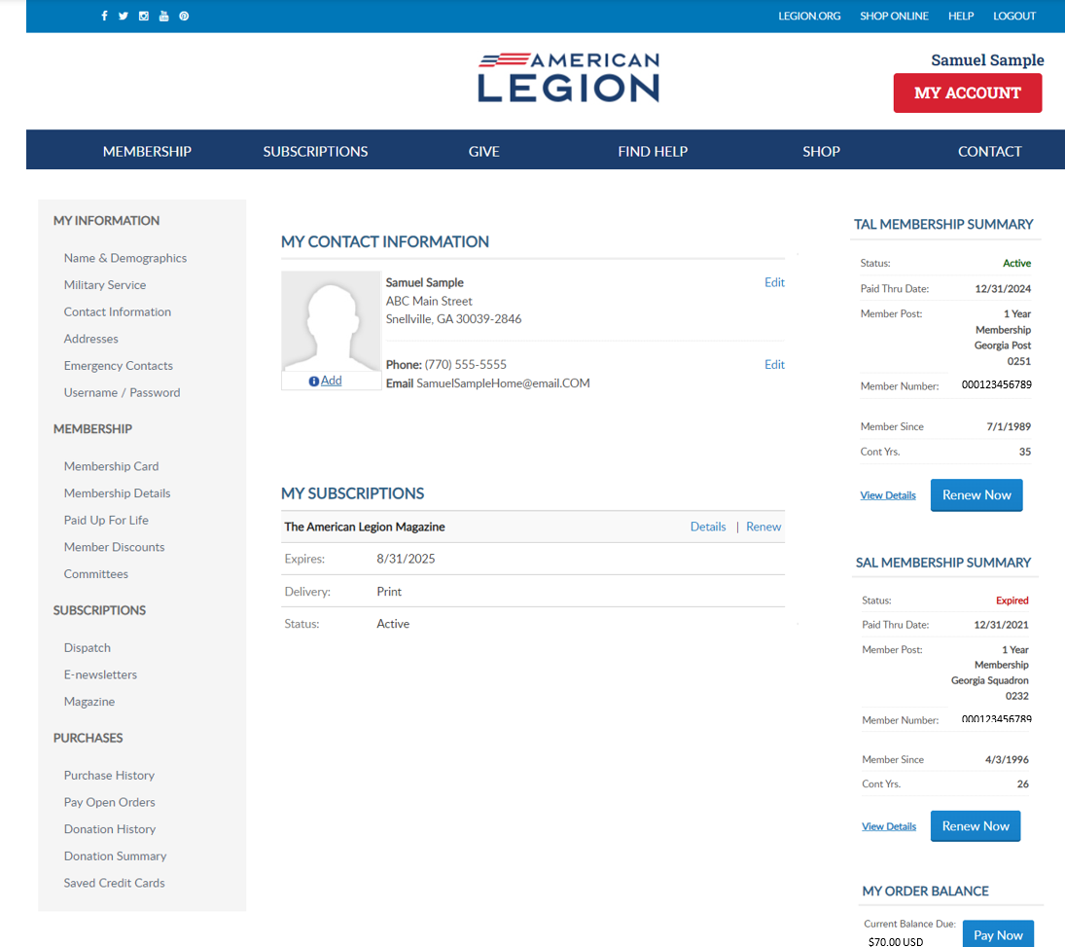
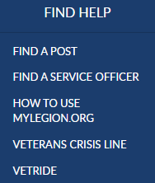
MY ACCOUNT & HELP RESOURCES
Notes:
Learn more about MyLegion using “Find Help” and go to How to use MyLegion.org.

Slide 27
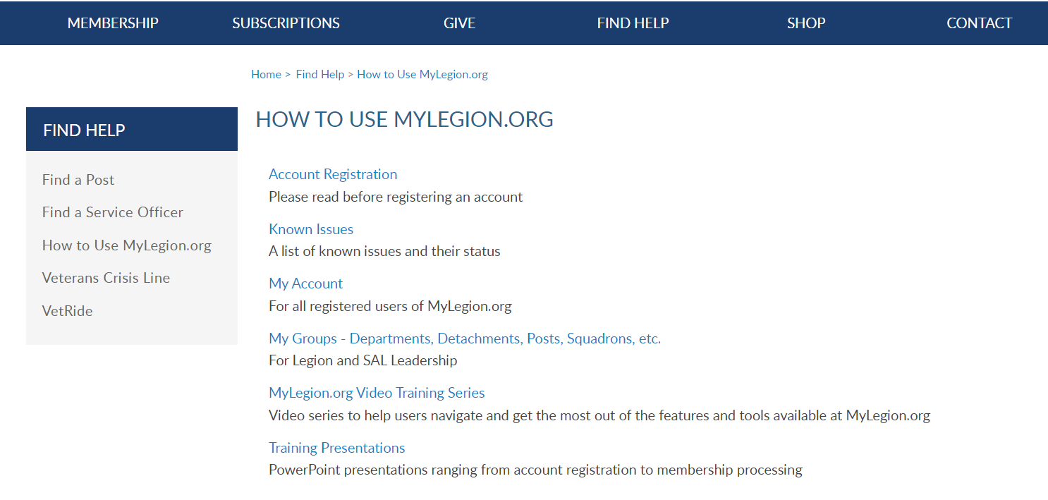
Online Help
Notes:
Step by step instructions, videos and training presentations will assist with how to manage your member account and groups in MyLegion.

Slide 28
Contact your department or national MyLegion support to assist with any questions or help with MyLegion.
MyLegion@legion.org
833.253.9995
Monday – Friday
8:00am – 4:30pm
(Eastern)
Notes:
Contact your department or national MyLegion support to assist with any questions help with MyLegion.

